Slide 1
INF10025
Data Management and Analytics
Lecture 6 – Part 1
Foreign Key Constraints & relationships
Participation Constraints
Not Null constraints

Slide 2
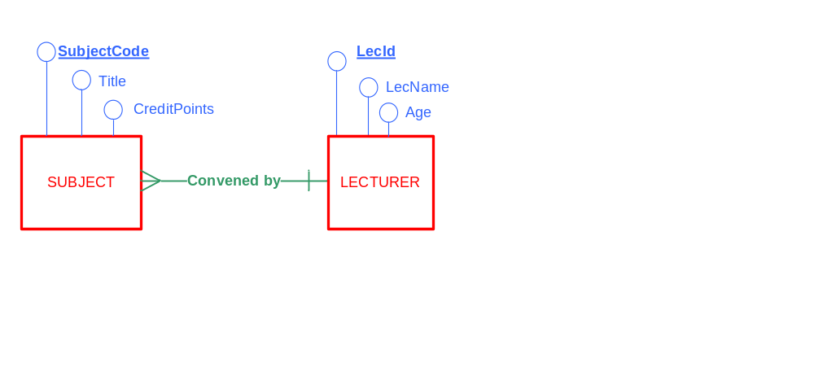
Recap: Entity Relationship Diagrams
ERDs
  Based on Business Rules
  Describes data that organisation want to store
  Shows relationships between entities
Attribute
(Property of an Entity)
Entity
(Real World Things)
Relationship
(between entities)

Slide 3
Recap: Convert ERD to Relational Model
The ERD is converted to a Relational Schema
  Step 1: Each Entity becomes a Relation
  Step 2: Add attributes to the relations
  Step 3: Identifiers become Primary Keys
LECTURER (LecId, LecName, Age)
SUBJECT(SubjectCode, Title, CreditPoints )

Slide 4
Recap: Convert ERD to Relational Model
Step 4: The entity at the Many end of the the M:1 relationship will give rise to a Foreign Key in the matching table
Foreign Key values must match
Primary Key values (or be null)
LECTURER
LecID | LecName | Age
207 | John Smith | 37
119 | Jane Pitt | 26
345 | Carol Kent | 34
LECTURER (LecId, LecName, Age)
SUBJECT(SubjectCode, Title, CreditPoints, LecId)
Foreign Key (LecId) References LECTURER
SUBJECT
SubjectCode | Title | CreditPoints | LecId
INF11002 | Intro to Web | 12.5 | 207
INF11007 | EBIS | 12.5 | 345

Slide 5
Recap: SQL DDL Create Table
The Relational Schema is the specification for the database
  The tables are constructed using SQL DDL statements
  Primary Key and Foreign Key constraints are implemented
  Create Table LECTURER (
    LecId number ,
    LecName varchar(50) ,
    Age number ,
    Primary Key (LecId) ) ;
  Create Table SUBJECT (
    SubjectCode varchar(10) ,
    Title varchar(100) ,
    CreditPoints number ,
    LecId number ,
    Primary Key (SubjectCode) ,
    Foreign Key (LecId) References LECTURER ) ;

Slide 6
Foreign Key Constraints
In a FK – PK relationship
  The Primary Key column is often referred to as the Parent
  The Foreign Key column is often referred to as the Child
The Parent is found at the One end
of a M:1 relationship
  - A child has one parent
The Child is found at the Many end
of a M:1 relationship
  - A parent may have many children
LECTURER
PK
LecID | LecName | Age
207 | John Smith | 37
119 | Jane Pitt | 26
345 | Carol Kent | 34
SUBJECT
FK
SubjectCode | Title | CreditPoints | LecId
INF11007 | EBIS | 12.5 | 345
AST80016 | Astrophysics | 12.5 | 222
INF11011 | Cobol | 12.5 | 345

Slide 7
Foreign Key Constraint
The FK constraint:
  Forces the RDBMS to validate the value entered into
  the Foreign Key column
  An error results if the Foreign Key
  value does not match the
  primary key of the related table
LECTURER
LecID | LecName | Age
207 | John Smith | 37
119 | Jane Pitt | 26
345 | Carol Kent | 34
SUBJECT
FK column
SubjectCode | Title | CreditPoints | LecId
INF11007 | EBIS | 12.5 | 345
AST80016 | Astrophysics | 12.5 | 222
… Inserted OK
… Error – Parent Key not Found

Slide 8
Foreign Key constraints messages
  Sample results of validation of foreign key constraints in iSQL Jr :
  INSERT INTO SUBJECT ( SubjectCode, Title , CreditPoints, LecId )
    VALUES ('INF11007', 'EBIS', 12.5, 345) ;
  OK. 1 rows - cryptic message than means 1 row added successfully
  INSERT INTO SUBJECT ( SubjectCode, Title , CreditPoints, LecId )
    VALUES ('AST80016', 'Astrophysics', 12.5, 222 ) ;
  Error at line 1:
  ORA-02291: integrity constraint (s1234567.SYS_C002969703)
  violated - parent key not found
  This message means that no parent (primary key)
  value matched the value 222

Slide 9
Parent / Child rules
The default situation in Oracle is that:
  A parent cannot be deleted if a child exists.
  I.e. A child cannot become orphaned
  A parent can only be deleted if the children no longer exists
  (Same rule applies in MS Access if you have ticked the
  Enforce Referential Integrity option in Relationship Diagram)

Slide 10
Parent / Child rules
Add lecturer Carol
  INSERT INTO LECTURER ( LecId, LecName, Age )
  VALUES (345, 'Carol Kent', 34) ;
  Add subject INF1107 where Carol is the covenor
  INSERT INTO SUBJECT ( SubjectCode, Title , CreditPoints, LecId )
    VALUES ('INF11007', 'EBIS', 12.5, 345) ;
  Attempt to delete Carol's record from the Lecturer table
  DELETE FROM LECTURER WHERE LecId = 345;
  Oracle Error at line 3:
  ORA-02292: integrity constraint (s1234567.SYS_C002969703) violated - child record found
This Oracle message means that you are attempting to orphan a child

Slide 11
Null Foreign Keys
It is not uncommon for a Foreign Key to have a NULL value
Nulls are acceptable as Foreign Key values
Imagine that we plan for a new subject to begin next year
  INF21009 Adv Facebook
  However, the business does not yet know who the lecturer will be for that unit
INSERT INTO SUBJECT ( SubjectCode, Title , CreditPoints, LecId )
    VALUES ('INF21009', 'Advanced Facebook', 12.5, Null) ;
LECTURER
LecID | LecName | Age
207 | John Smith | 37
345 | Carol Kent | 34
SUBJECT
SubjectCode | Title | CreditPoints | LecId
INF11007 | EBIS | 12.5 | 345
INF21009 | Adv Facebook | 12.5
LecId has a NULL
value is OK

Slide 12
Null Constraint
Imagine that a new business rule is introduced that says
'Every subject MUST have a convener'
  A null value for the lecturer ID is not acceptable
How can the be enforced?
  Each column in a table can have a Null constraint.
  It is usually defined in the Create Table statement
    Although you can add a constraint at a later time
Create Table SUBJECT (
  SubjectCode varchar(10) ,
  Title varchar(100) ,
  CreditPoints number ,
  LecId number Not Null,
  Primary Key (SubjectCode) ,
  Foreign Key (LecId) References LECTURER ) ;

Slide 13
Null Foreign Keys
The RDBMS will now generate an error if you attempt to
insert a row that breaks the Not Null constraint
INSERT INTO SUBJECT ( SubjectCode, Title , CreditPoints, LecId )
    VALUES ('INF21009', 'Advanced Facebook', 12.5, Null) ;
Error at line 1:
ORA-01400: cannot insert NULL into (s1234567.SUBJECT.LECID)

Slide 14
Null Constraints
Many columns in a table may have Not Null constraints
Three columns in this table will generate an error if a Null is entered
  NOTE: The Primary Key does not require a Not Null constraint
  Primary Keys values cannot be null
Create Table SUBJECT (
  SubjectCode varchar(10) ,
  Title varchar(100) Not Null ,
  CreditPoints Number ,
  LecId Number Not Null ,
  Primary Key (SubjectCode) ,
  Foreign Key (LecId) References LECTURER ) ;

Slide 15


Participation constraints
ERDs have participation constraints
This a similar notion to database Not Null constraints
The participation constraint is drawn on the relationship line between two entities
A single line | indicates that participation is MUST
  A subject must be convened by a lecturer
  Participation is mandatory
A circle ○ indicates that participation is MAY
  A subject may be convened by a lecturer
  Participation is optional

Slide 16
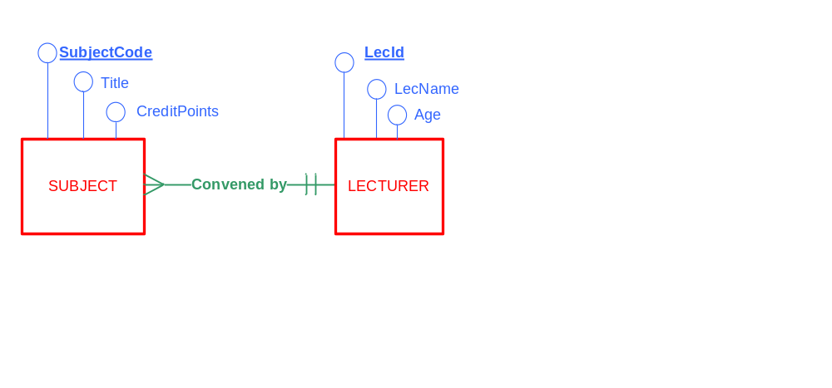
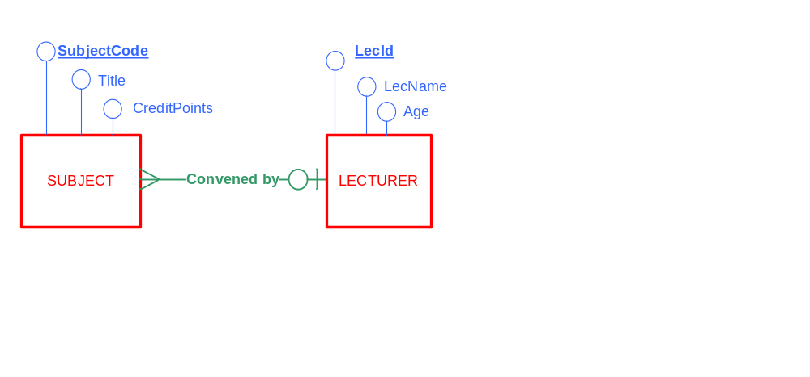
Participation constraints
Participation Examples
  One Subject must be Convened by One Lecturer
  One Subject may be Convened by One Lecturer

Slide 17
Cardinality & Participation constraints
Cardinality constraints are vital to an ERD
  They determine the number of tables that will be
  developed in your database
Participation constraints are less important in an ERD
  They do not affect the number of tables or columns that will exist in your database
  Participation simply specifies whether Not Null constraints
  are required in tables when the database is implemented.

Slide 18


Cardinality & Participation constraints
Generally, the Many end of a relationship has optional participation.
  e.g. The parent MAY have many children .
It is recommended that you always draw optional participation at the many end
Mandatory participation at both ends causes database dilemmas
Imagine if your ERD said that
  "A Child must have a Parent and a Parent must have a Child"
  How can data be inserted?
    A parent cannot be added as it must already have a child !
    A child cannot be added as it must already have a parent !
Database developers sometimes switch off such constraints when loading
a database with initial data and then switch on the constraints from
that point onwards. Not recommended for day-to-day operations.

Slide 19
SQL: Calculations & the Select clause
The Select clause can include
  Column names
  Expressions or calculations
Example with a calculation:
  SELECT Name, Test1, Test2, Test1+Test2
  FROM StudentResults
  SELECT Name, Test1, Test2, Test1+Test2
  FROM StudentResults
  ORDER BY 4 DESC;
Name | Test1 | Test2 | Test1+Test2
Ted | 10 | 5 | 15
Sue | 5 | 6 | 11
Emma | 9 | 9 | 18
Name | Test1 | Test2 | Test1+Test2
Emma | 9 | 9 | 18
Ted | 10 | 5 | 15
Sue | 5 | 6 | 11
Sort the result set by the 4th column

Slide 20
Column Headings & the Select Clause
The Select clause can include
  Alternative columns headings (only used in the result set)
    Use the AS keyword
      AS keyword is optional!
    New heading is specified in DOUBLE QUOTES
      Double quotes are optional if single word is used
Example with a new column headings:
  SELECT Name, Test1, Test2,
  Test1+Test2 As "Total Score"
  FROM StudentResults
  SELECT Name "Student Name", Test1, Test2,
  Test1+Test2 "Total Score"
  FROM StudentResults
  ORDER BY Name;
  SELECT Name StudentName, Test1+Test2 Total, …
Name | Test1 | Test2 | Total Score
Ted | 10 | 5 | 15
Sue | 5 | 6 | 11
Emma | 9 | 9 | 18
Student Name | Test1 | Test2 | Total Score
Emma | 9 | 9 | 18
Sue | 5 | 6 | 11
Ted | 10 | 5 | 15

Slide 21
SQL:Table name qualification
Last week, we wrote a simple SQL query using the Select statement
SELECT LecId, LecName, Age FROM lecturer
Whenever we use a column name in a Query, we can qualify (prefix)
with the appropriate table name
SELECT lecturer.LecId, lecturer.LecName, lecturer.Age
FROM lecturer
The usefulness of this feature becomes apparent when
SQL statements refer to columns from two or more tables

Slide 22
SQL:Table name aliases
Tablenames in SQL statements may be assigned a temporary alias
  The alias only applies to the current SQL statement (not remembered)
  Once an alias is used within an SQL statement, you can cannot refer to the original tablename within that SQL statement
1 SELECT lecturer.LecId, lecturer.LecName, lecturer.Age,
FROM lecturer
WHERE lecturer.age => 50;
2 SELECT L.LecId, L.LecName, L.Age
FROM lecturer L
WHERE L.age => 50;
3 SELECT budget.deptno, budget.monthly_amt
FROM wr207_V_X5 budget
WHERE budget.year = 2011;
no alias used
L is the alias for the lecturer table
budget is the alias for the table named
wr207_V_X5

